Slide 1
Applications of Stack

Slide 2
Parenthesis Matching
Given a parenthesized expression, to test whether the expression is properly parenthesized.

Slide 3
Parenthesis Matching
Works for multiple types of parentheses
( )
{ }
[ ]

Slide 4
Parenthesis Matching
Whenever a left parenthesis is encountered,
it is pushed in the stack.
Whenever a right parenthesis is encountered,
pop from stack and check if the parenthesis match.

Slide 5
Parenthesis Matching : Example

Slide 6
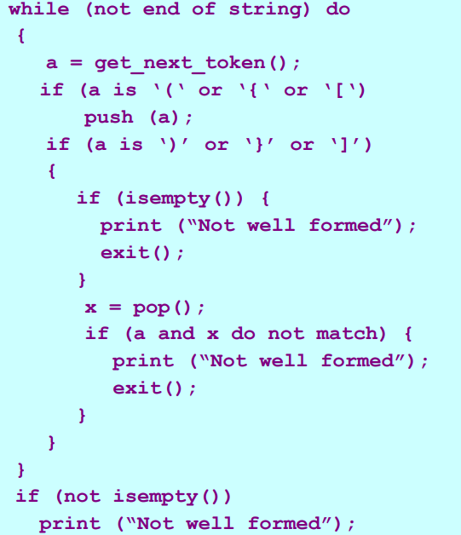
Algorithm

